Slide 1
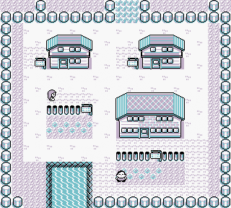
Pokémon : Gotta select * FROM all
Team Rocket Recruits:
Jordan Tiu
Matt Hopkins
Reed Bader

Slide 2



Introduction:

Slide 3
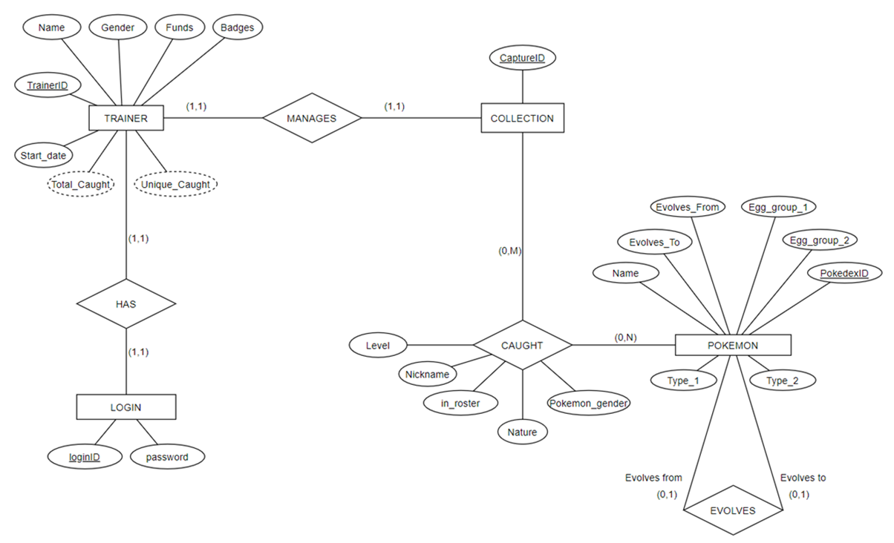

Slide 4
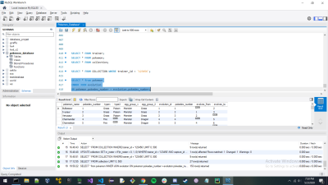
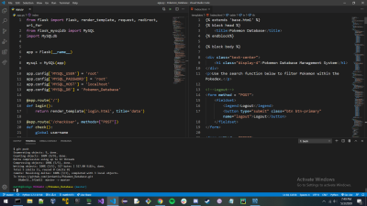
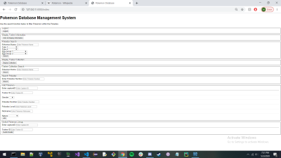
The PC and database of Pokémon
MySQL
Python w/ flask extension & MySQL connector

Slide 5

Issues and Setbacks
Using an ASP.Net framework with C#
Solution – used Python with a Flask extension
Setting up the environment to work in

Slide 6
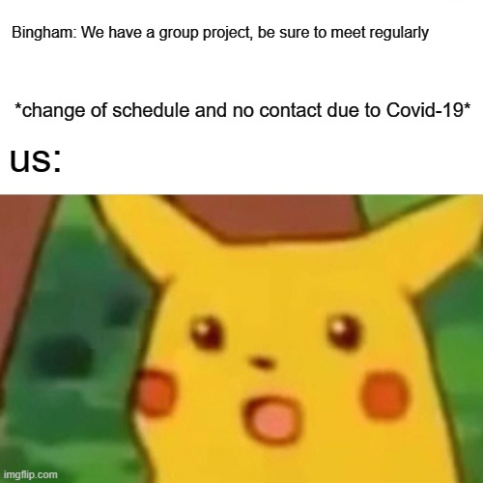
Conclusion
Overall it was a great project and we had a lot of fun learning and building our own database. There are things we could have improved upon, especially the css, but we are happy with our result.

